Slide 1




Designing the Data Collection Form for Communication Data

Slide 2
Learning Objectives
Define telescoping error and recall loss and explain how they affect a respondent’s ability to answer questions accurately
List some techniques that researchers use to secure respondents’ cooperation in answering sensitive questions
List some of the primary rules researchers should keep in mind in trying to develop bias-free questions
Explain what the funnel approach to question sequencing is
Explain what a branching question is and discuss when it is used
Explain the difference between target information and classification information and tell which should be asked first in a questionnaire
Explain the role of pretesting int eh questionnaire development process

Slide 3
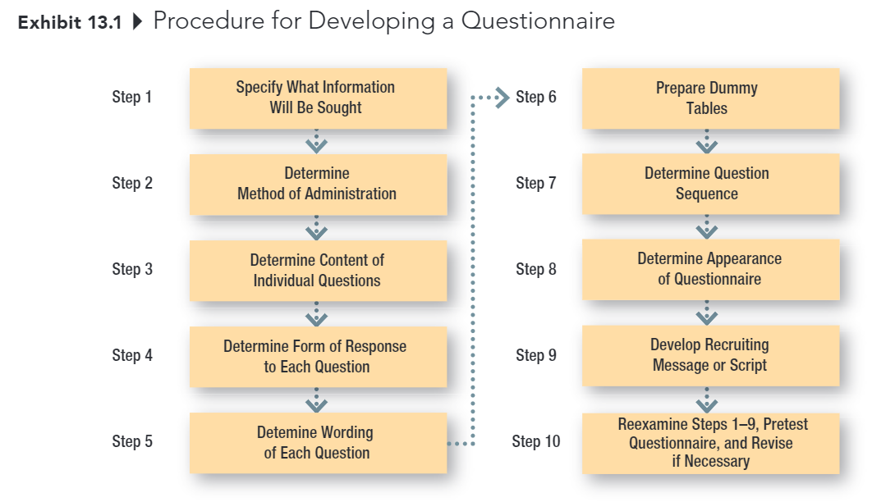
Developing the Data Collection Form

Slide 4
Step 1: Specify what info is needed
The first step should be relatively easy, assuming that the researchers have done a good job at earlier stages in the research process
Hypotheses, dummy tables, etc., make it clear what information is needed

Slide 5
Step 2: Determine Method of Administration
The degree of structure and disguise influence this decision, as does the specific research situation
Personal Interview
Telephone Interview
Mail Survey
Online Survey

Slide 6
Step 3: Determine Content of Individual Questions
Some key issues:
Is the question necessary?
Are several questions needed instead of one?
Do respondents have the necessary information?
Will respondents give the information?
Filter Question:
Do you do the grocery shopping for your family?
Have you eaten at Mickey’s restaurant, located …, within the past 6 months?
Did you vote in the last presidential election?
Telescoping error
Recall loss
Notes:
Filter: A question used to determine if a respondent is likely to possess the knowledge being sought; also used to determine if an individual qualifies as a member of the defined population
Telescoping error: A type of error resulting form the fact hat most people remember an event as having occurred more recently than it did
Recall loss: A type of error caused by a respondent’s forgetting that an event happened at all

Slide 7
Handling Sensitive Questions
Don’t ask unless absolutely necessary!
Guarantee anonymity
Place sensitive questions near end
Include a counter biasing statement
Ask about how others might feel
Ask for general, rather than specific, information (e.g., categories for answers)
Use randomized response model
Notes:
Randomized response model: An interviewing technique in which potentially embarrassing and relatively innocuous questions are paired, the question the respondent answer is randomly determined but is unknown to the interviewer

Slide 8
Example Response Model
Q1: Have you used cocaine before?
Q2: Flip a book and answer: is the page number odd? Yes or no?
The respondent: flip a coin to decide which question to answer
The interviewer: does not the outcome of the coin
The randomization device must have:
Known probability t that the person is asked the sensitive question and (1-t) that the person is asked other questions
The probability that the person response yes to the other question is known

Slide 9
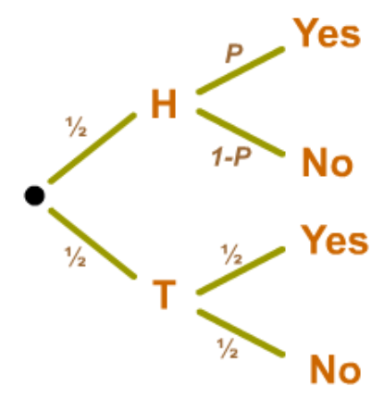
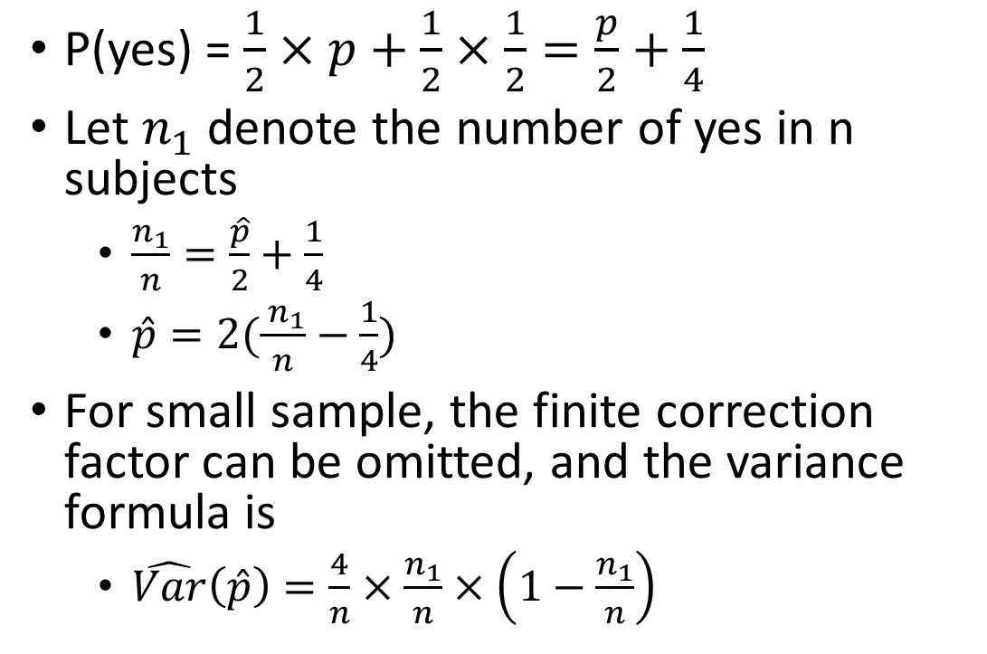
Example Response Model (cont.)
P(yes) = $\frac{1}{2}×p+\frac{1}{2}×\frac{1}{2}=\frac{p}{2}+\frac{1}{4}$
Let $n_{1}$ denote the number of yes in n subjects
$\frac{n_{1}}{n}=\frac{\hat{p}}{2}+\frac{1}{4}$
$\hat{p}=2(\frac{ n_{1}}{n}−\frac{1}{4})$
For small sample, the finite correction factor can be omitted, and the variance formula is
$\hat{Var}\left(\hat{p}\right)=\frac{4}{n}×\frac{n_{1}}{n}×\left(1−\frac{n_{1}}{n}\right)$
Notes:
Example from PSU stat https://online.stat.psu.edu/stat506/lesson/12/12.3

Slide 10
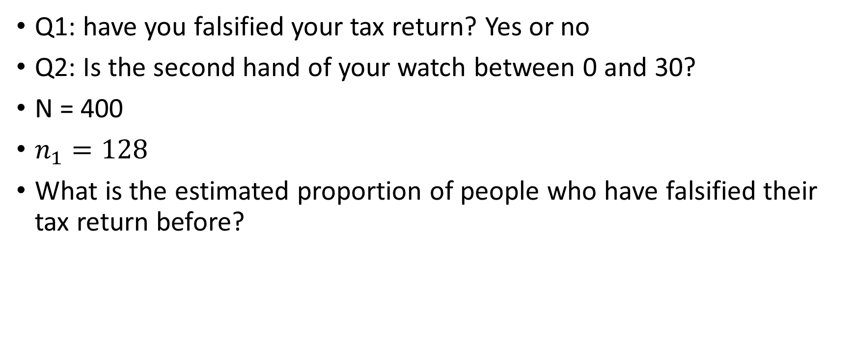
Bonus Question (Extra Credit)
Q1: have you falsified your tax return? Yes or no
Q2: Is the second hand of your watch between 0 and 30?
N = 400
$n_{1}=128$
What is the estimated proportion of people who have falsified their tax return before?
Notes:
P = 2(128/400 – ¼) = 0.14

Slide 11
Counterbiasing Statement
Recent studies show that one of every four households has trouble meeting its monthly financial obligations. Is your household currently experiencing financial difficulties?
Yes
No

Slide 12
Step 4: Determine Form of Response to Each Question
Open-Ended Questions vs. Closed-Ended Questions

Slide 13
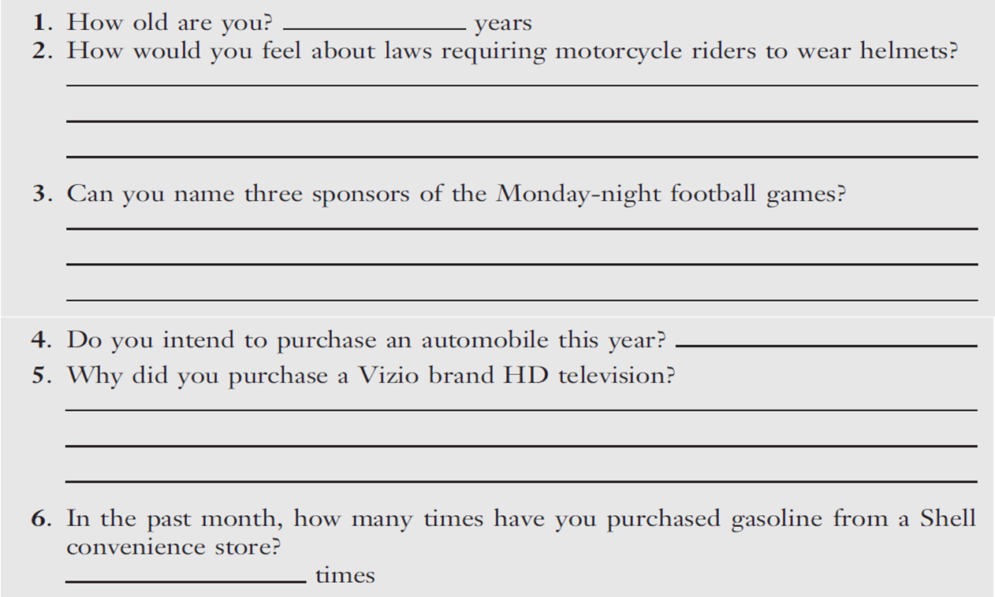
Open-Ended Questions

Slide 14
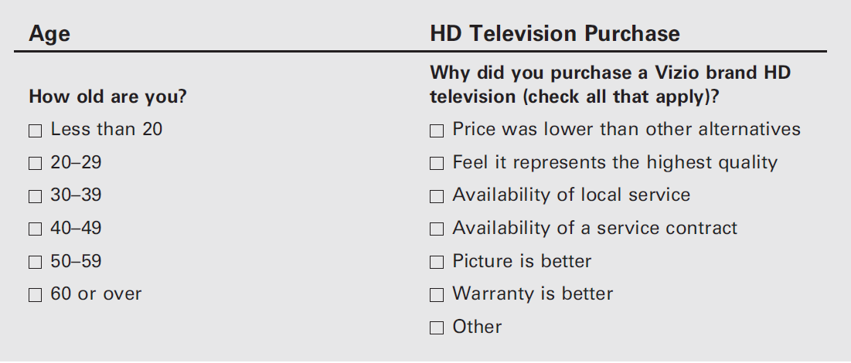
Closed-Ended Questions

Slide 15
Close-Ended Questions
With closed-ended questions, the response categories must be exhaustive; all reasonable responses must be included
In addition, response categories must be mutually-exclusive, except in special cases where more than one answer is acceptable (e.g., check all that apply)

Slide 16
Response Order Bias
Response Order Bias
An error that occurs when the response to a question is influenced by the order in which the alternatives are presented

Slide 17
Split-Ballot Technique
A technique for combatting response bias in which researchers use multiple versions of a survey, with different wordings of an item or different orders of response options
(Version A) Do you think gasoline will be more expensive or less expensive next year than it is now?
◻ More expensive
◻ Less expensive
(Version B) Do you think gasoline will be more expensive or less expensive next year than it is now?
◻ Less expensive
◻ More expensive

Slide 18
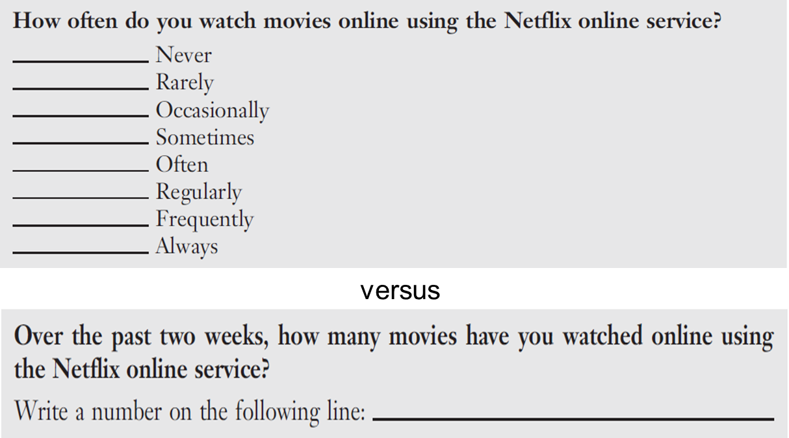
Step 5: Determine Wording of Each Question
Use simple words
Language used should be driven by the ability level of the population; err on the side of simplicity
Avoid Ambiguous Word and Questions

Slide 19
Some Problem Words: Be Careful!
All
Always
And
Dinner
Feel
Government
If
Never
Occasionally
Often
Or
Rarely
Regularly
Sometimes
Usually
Where
You

Slide 20
Step 5: Determine Wording of Each Question
Avoid Leading Questions

Slide 21
REMINDER: No Advocacy Research
Reputable media outlets provide
(a) the actual questions
(b) a description of the study
© information about he sample

Slide 22
Words that Might Signal Leading Questions
Allege, allude, arbitrary, blame, claim, demand, error, failure, fault, ignore, ill-advised, ill-informed, incompetence, ineptness, insist, just, maintain, misinformed, must, neglected, one-sided, only, overreact, peremptory, purport, questionable, rejection, rigid, so-called, unfortunately, unilateral, unreasonable
Notes:
Source: “Guide to Writing Survey Questions,” Management Analysis and Development, downloaded from http://www.mad.state.mn.us/ on October 25, 2012.

Slide 23
Things to be Avoid
Avoid Unstated Alternatives
An alternative answer that is not expressed in a question’s options
Thorough exploratory research and questionnaire pre-testing is the answer!
19% said “no” “Would you like to have a job, if this were possible?”
versus
68% said “no” “Would you prefer to have a job, or do you prefer to do just your housework?”

Slide 24
Things to be Avoid

Slide 25
Things to be Avoid

Slide 26
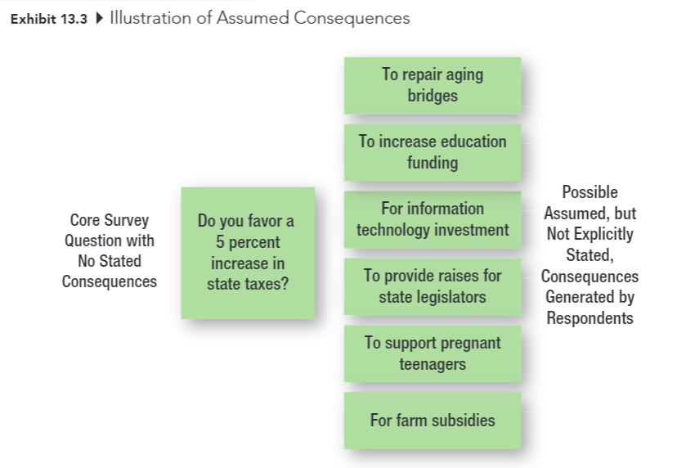
Things to be Avoid
Avoid Assumed Consequences
When a question is not framed to clearly state the consequences and thus generates different responses from individuals who assume different consequences
Would you like to double the number of job offers you receive as a senior?
◻ Yes  ◻ No
Would you like to double the number of job offers you receive as a senior if that means devoting an additional 10 hours per week to studying so as to raise your grade point?
◻ Yes  ◻ No

Slide 27
Things to be Avoid
Avoid Generalizations and Estimates
Questions should always be asked in specific, rather than general terms
When asking about the frequency of behaviors (e.g., shopping, purchase) use an appropriate item frame that doesn’t force respondents to make estimates

Slide 28
Things to be Avoid
Avoid Double-Barreled Questions
Watch out for and and or…

Slide 29
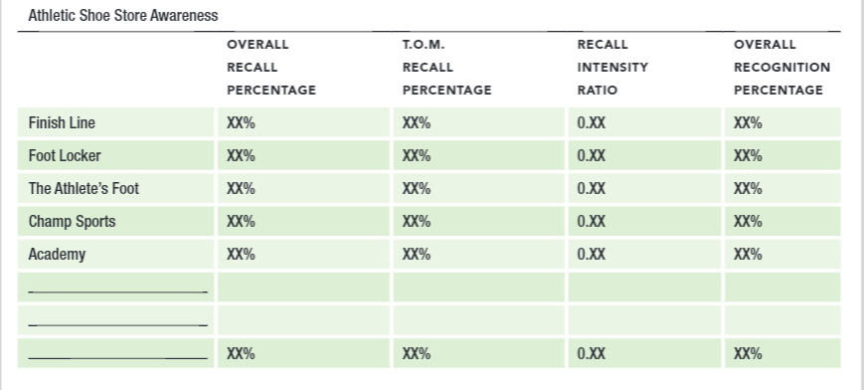
Step 6: Prepare Dummy Tables
Dummy Table: A table (or figure) used to show how the results of an analysis will be presented

Slide 30
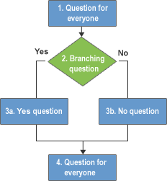
Step 7: Determine Question Sequence
Use simple and interesting opening questions
Use the funnel approach
State with broad questions and progressively narrow the scope
Question Order bias: the tendency for earlier questions on a questionnaire to influence respondents’ answers to later questions
Design branching questions with care
Branching questions direct respondents to different places in a questionnaire, based on their response to the question at hand

Slide 31
Step 7: Determine Question Sequence
Ask for classification information last
Target info: The basic info that addresses the subject of the study
Classification info: Information used to classify respondents, typically for demographic breakdowns
Place difficult or sensitive questions late in the questionnaire

Slide 32
Step 8: Determine Appearance of Questionnaire
No clutter!
Keep is as short as possible
Use care with branching questions
Use graphics as needed to improve appearance
Number question within sections
1-1, 2-1, 3-1, 2-1, 2-2, etc.
Include an organization name (sometimes fictitious) and project title
Go easy on instructions, unless they are absolutely necessary (again, see second bullet point)

Slide 33
Step 9: Develop Recruiting Message or Script
Good cover letters and scripts are NOT written ina hurry
The usually things to include
Who you are
Why you are contacting them
Promise of anonymity or confidentiality
The request for help
How long it will take
Any incentives

Slide 34
Step 10: Reexamine step 1-9, Pretest
Developing a questionnaire is a VERY difficult process. It normally requires several revisions of the data collection form
Pretest: Use of a questionnaire (or observation form) on a trial basis in a small pilot study to determine how well the questionnaire (or observation form) works
The real test of a questionnaire is how it performs under actual conditions of data collection
Data collection should NEVER begin until you have pretested – and probably revised again –the questionnaire

Slide 35
Observation Forms
Decisions about …
WHO should be observed?
What aspects should be reported?
WHERE should the observation be made?
WHEN should the observation be made?

